Slide 1
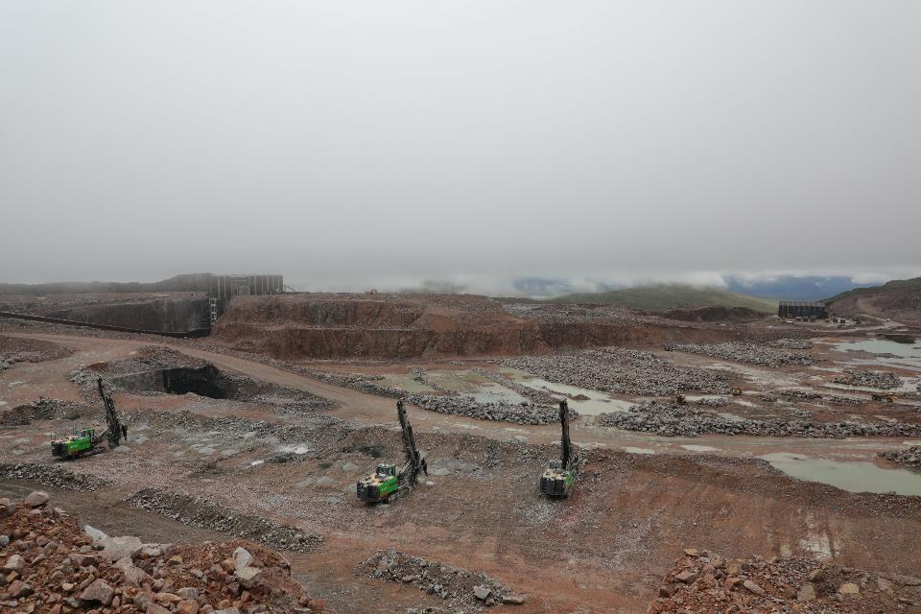
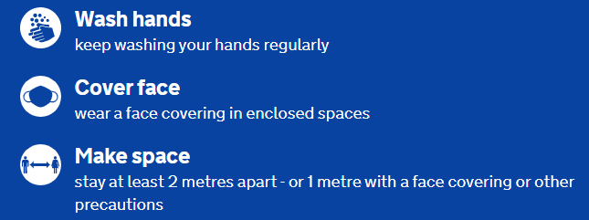

Winter 2018
Home safe every day
Winter 2020
Notes:
Winter briefing - 2020
On March 29th we changed the clocks at the start of Summer time. A lot has happened since and on October 25th we change the clocks again for Winter.
COVID-19 is still with us and after six months we cannot become complacent. Stick to the COVID-19 rules and hopefully we can get to the new normal as soon as possible. Stay alert please.
As we approach the end of summer time as marked by the turning back of the clocks there are a number of things we must add into our planning and executing of work.
We will review plans in the context of winter working - Some winter hazards may require to be added to existing Activity plans– . Some items are seasonal hazards of themselves, others increase the significance of existing hazards. These include - Human Factors; Temperature and wind chill; Wind; Precipitation – rain / snow / frost; Lighting / visibility
To date (end of September) in 2020 there have been 30 lost time injuries, with 8 of these occurring in the winter months Jan/Feb, we cannot simply accept that negative events happen because it is winter. Increased attention and effort is required from everyone to ensure we are actually delivering on Your Safety is My Safety.
Throughout the Spring and Summer and into Autumn we have been working in a COVID-19 environment and still do. This has had no discernible impact on the level of injuries on site – in fact they are roughly the same. Levels of absence through illness have dropped sharply on the other hand.
The important message is that the hazards on site remain and our vigilance must continue as the influence of Winter arrives.

Slide 2
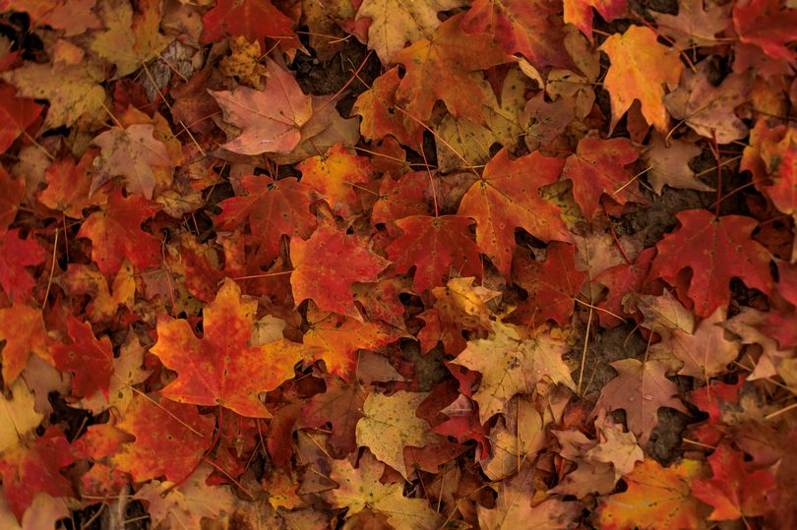

Winter 2018
Home safe every day
Daylight hours
Notes:
The changing of the clock and the shortening daylight hours will affect how we consider lighting and possibly even working hours. The location of projects is important.
The further north you go the less daylight you will have – when planning for, and placing temporary lighting, consider general access as well as task lighting, think about where there may be shadows or glare.
Head torches must be used to assist with moving around but do provide limited lighting and are therefore not suitable as task lighting.
Please also consider those who may be fuelling up or switching on and off temporary lighting, can they safely get to where they need to be, and see to do so?

Slide 3
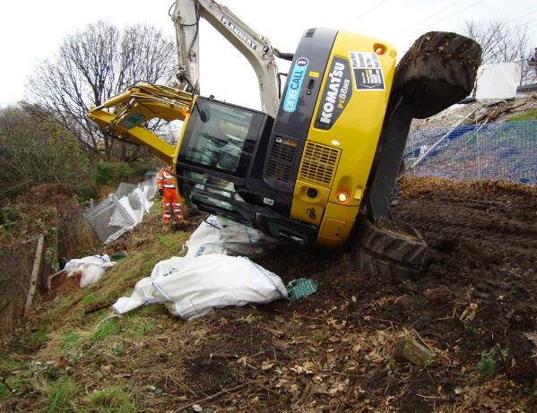
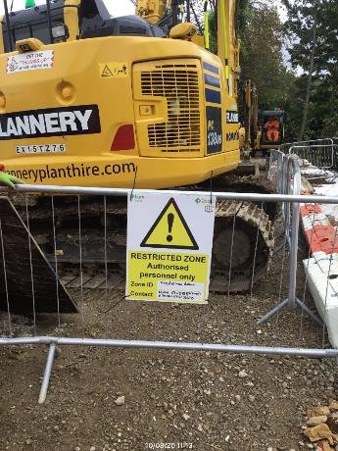

Home safe every day
Plant and vehicle hazards
Notes:
Another aspect of shortening daylight is the sun being low in the sky in the morning and late afternoon which may cause glare and cause plant operators and drivers to have limited visibility from their operating position.
This could be the case for both their direct line of sight and mirrors and / or cameras.
It is vital that zonal working around operated plant is robustly implemented and maintained as well as provision of segregated walkways so you do not need to enter the routes used by plant and vehicles.
Walking routes will where possible be extended to all areas where personnel are going to work.
Where cabs are fitted, operators must ensure wipers and washers are functional and used.
For any windows not fitted with wipers or washers, these need to be maintained in a clean condition to support all round visibility any time the item of plant needs to move – if they require cleaning every time, they must be cleaned every time.
Think also about accessing onto plant and therefore working at height, for cleaning windows and mirrors of muck or frost. If you are an operator, always ensure you complete your daily checks and report any defects. If you are supervising plant operations make sure the checks are being done and that reported defects are being repaired please.
As temperatures drop, operators may be wearing additional layers of bulky clothing which can in turn, inadvertently catch on controls etc. causing unexpected movements. Segregation and zonal working are therefore even more important as necessary controls.
Since the introduction of zonal working there have been several instances where items of plant have overturned. In many cases the plant was operating within restricted zones thus minimising access to personnel and therefore the possibility of injury.
Zonal working is important.

Slide 4
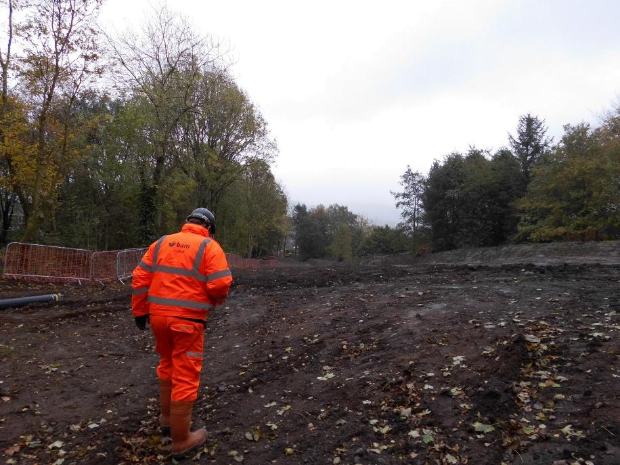
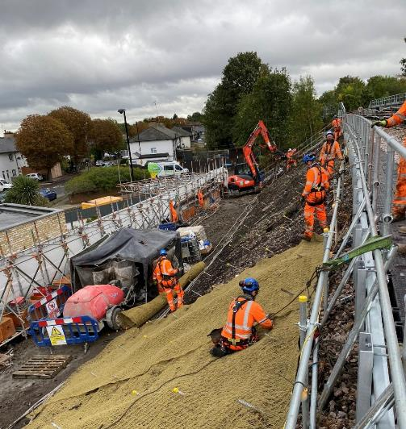

Home safe every day
Seasonal hazards
Notes:
The condition of vehicle routes need to be suitable and passable for vehicles and plant using them – road going delivery vehicles may no longer be able to access locations they could in better weather. The same is true for walking routes which need to well drained and free from slip and trip hazards. Puddles / muck / snow will cover trip hazards so be careful when walking please.
Look for where puddles form as these may subsequently freeze and consider how these low areas can be drained or up-filled to remove the potential - don’t simply think about de-icing salt, save that for melting any snow we may get.
Paths will be gritted when icy conditions are forecast, lets not wait until there is ice as those attempting to treat will be exposed to the slip hazard.
Muck on footwear may create slip fall hazards, or increase the risk of slips on getting into and out of operated plant or using ladders and steps.
Implement additional cleaning of walking surfaces and boot scrapers where surfaced walkways commence.
Always use the hand holds and steps provided when mounting and dismounting operated plant.
Where anti-slip surfacing may be required, use suitable materials – Roofing felt and chicken wire may look good but won’t last when walked on. Timber cleats, as long as they don’t Represent trip hazards or screw down anti-slip bars such as may be fitted on timber decking are much more effective, fit for purpose and reusable.
Pay particular attention to emergency evacuation routes and ensure that these remain available at all times. While considering emergency arrangements, are any fire extinguishers in danger of becoming inoperable due to frost?
Any locations where we have re-directed the public outside our works, from pavements, footpaths etc. or provided alternatives due to our works – it is our responsibility to manage these temporary routes and surfaces
If there is something not right with a route bring it to the attention of your supervisor immediately.

Slide 5
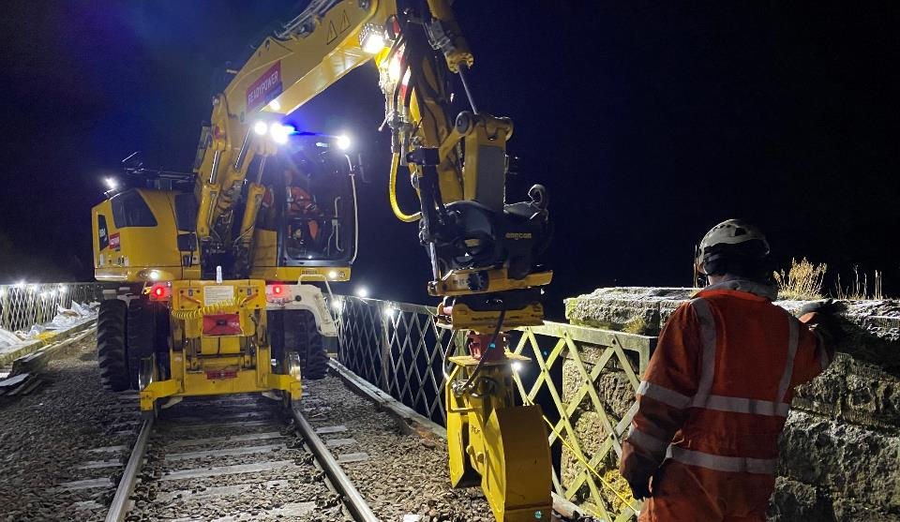

Home safe every day
Seasonal hazards
Notes:
Scaffolds or items of temporary works, will be inspected after any adverse weather conditions including snow, ice or wind loading.
The inspection is to ensure that they remains a safe place of work or safe access to a place of work.
Within excavations, the presence of water or snow may hide identifying marks and increase the potential for service strikes. Rain water run-off, waterlogging and frost action on excavation sides and stockpiles should also be considered when working in these areas.
For workplaces at height or in exposed locations, secure materials and tools from being blown around.
Materials being wet can ruin them or render them useless for working with in respect of quality of work, cover them to keep them dry.
Wet materials being held by surface tension or frozen together increasing the force required to separate them can lead to manual handling hazards. So please consider material storage during and at the end of shifts.
Cold conditions in general can make it more likely that muscle strains etc. can happen. Reduce the need for moving and handling objects by storing closer to work areas or using mechanical handling equipment.
Where there are lifting operations, consider wind conditions and visibility for operators and slinger signallers, access and lighting for slinger signallers.
There may be a need for lifting to be suspended if conditions become severe – ensure it is clearly understood who makes the decision to carry on or to stop and that they have the means of measuring wind speed. Bear in mind that materials with a large surface area may mean that operations need to halt at wind speeds much lower than the crane may be able to operate at.
Ensure any ice or snow is cleared off the load prior to lifting to ensure it does not increase the overall load nor fall off during the lift and present a further hazard.

Slide 6
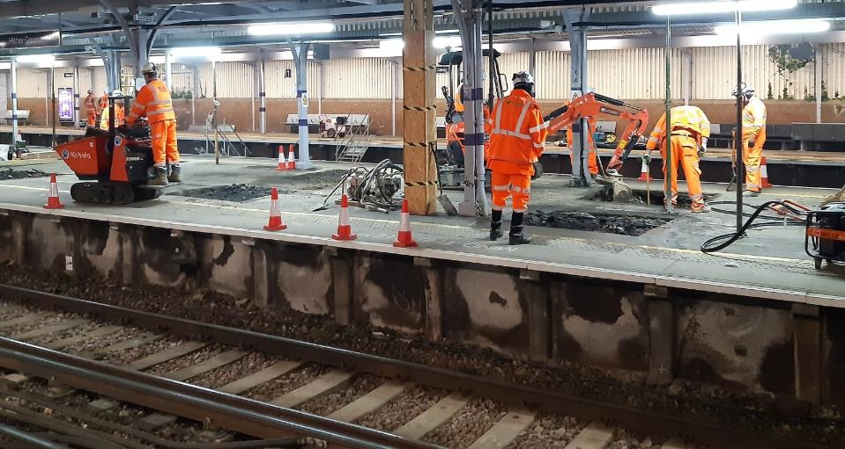
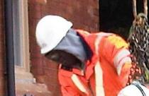

Home safe every day
Seasonal hazards
Notes:
Adverse weather conditions will affect people differently and we may also change our behaviours in response to the conditions.
Hi-Viz clothing must be kept in good order to protect you from the weather and to increase people’s (plant operators particularly) visibility of you in the darker conditions.
When wrapped up against the cold your collar or scarf may limit your vision, hearing and movements so please stay alert and look around you and ensure that any additional head wear worn under your helmet is suitable for use with that helmet and that it does not affect its performance or your field of vision.
It is more likely that some workers may grow beards or be unshaven we therefore can’t rely on tight fitting masks to protect them from respiratory hazards.
Tight fitting masks must not be issued to anyone who will not be protected by them. Ask if they will shave or provide loose fitting RPE – helmets or hoods as alternatives.
Don’t allow yourself to be exposed to respiratory hazards by not being properly protected by RPE.
Reduction in the temperature can make the effects of Hand arm vibration more pronounced, ensure that tasks are carried out by means other than with vibrating tools.
Where there are permitted operations, further reduce the length of time tools are used for and ensure there are means of warming the hands to improve circulation.

Slide 7
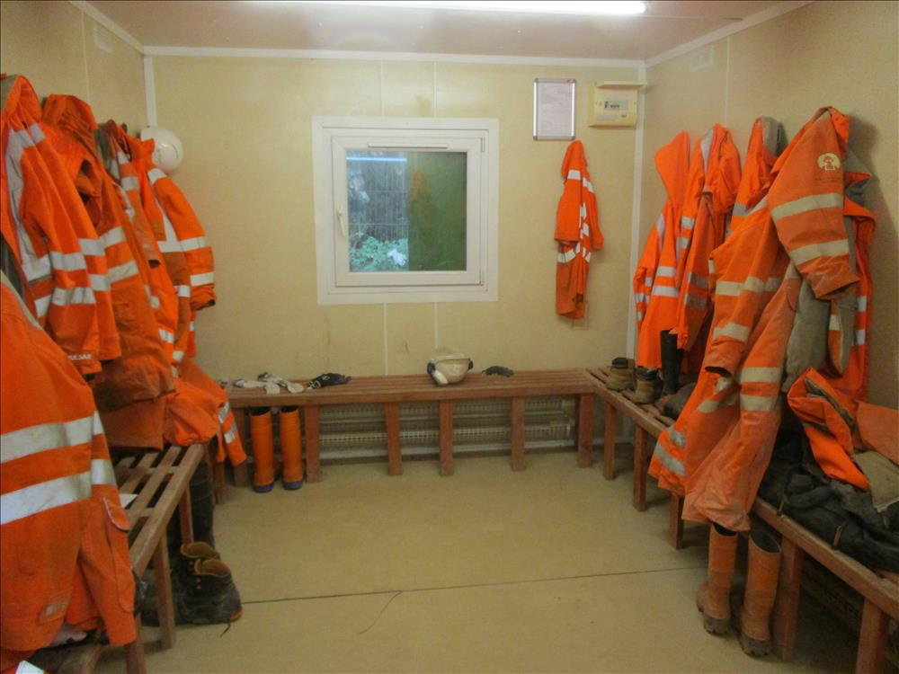

Home safe every day
Welfare facilities
Notes:
Our welfare facilities need to be protected from the elements, kept clean, lit and suitably warm as well as having facilities to prepare and eat food and boil water.
Where conditions are particularly harsh your supervisor will consider stopping work or taking a break.
Warming up before exercising at a gym is commonplace and the same practice is well worthwhile before commencing physical activity at work. Take a few moments to warm up before lifting or straining, to reduce your chances of spraining or straining yourself in the cold.
We must ensure we keep the welfare functional, if the water supply freezes and it’s not possible to wash hands after using the toilet or before eating, then we don’t have acceptable welfare. Heating and proper insulation of supply pipes may prevent this having to happen.
Facilities for storing and drying clothing, there can be little more demoralising than finding that working clothing is damp or cold when preparing for a day’s work.
Additional heating will not dry things out unless there is adequate ventilation.
People may well have additional sets of outer clothing and footwear for use at work during times of adverse weather and there can be additional pressure on storage. Active management of lockers and removal of redundant clothing may be necessary.

Slide 8
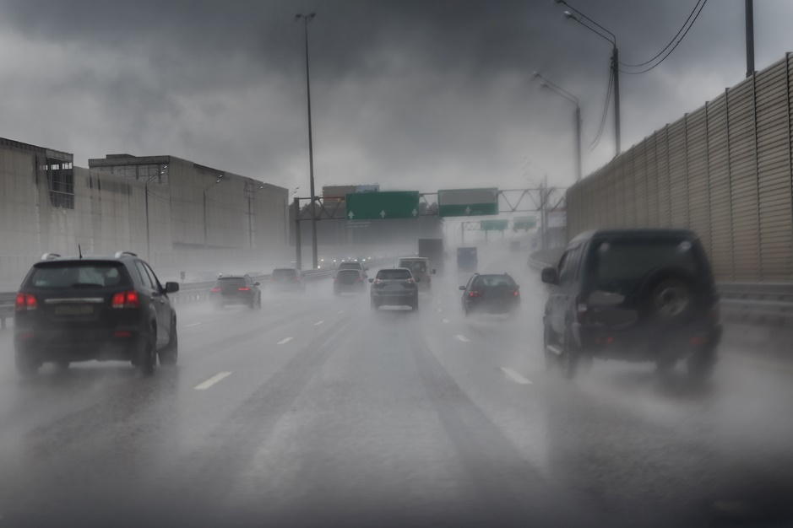

Home safe every day
Winter driving
Notes:
Winter driving
More of us than ever are driving to/from and around work due to COVID19 and its impact on public transport and the number of occupants in vehicles.
For those of us who commute to and from or drive at work and operate plant on the public highway, ensure that your vehicle is ready for winter; lights in working order, wipers working, screen wash bottle is full, heater working, tyres fully inflated and with good tread. Never use your mobile whilst driving and remember to wear your seat belt! If you have an accident the seat belt could save your life.
If your journey is absolutely necessary - plan it.
Check the weather forecast and road conditions.
Pay heed to weather warnings, if the advice is to avoid travel then you should not travel
Allow yourself more time to prepare the vehicle.
Clear all windows using a scraper and de-icer.
Consider alternative routes. Plan routes to favour major roads which are more likely to have been cleared and gritted.
Consider what you might need in an emergency-(warm clothing, blanket, water, fully charged mobile phone).
Consider alternative modes of transport, and check with bus, rail and air companies about any changes or cancellations to services.
Allow extra time for your journey and for any onward connections.
People are often struck by other road users after leaving their broken down or abandoned vehicles and setting out on foot, so if you do get stuck you should remain with your vehicle until help arrives unless you are absolutely certain that you can reach a place of safety without endangering yourself or others.
Abandoned vehicles are often the reason that gritters and snow ploughs cannot clear routes as conditions improve, they simply cannot get past them.

Slide 9
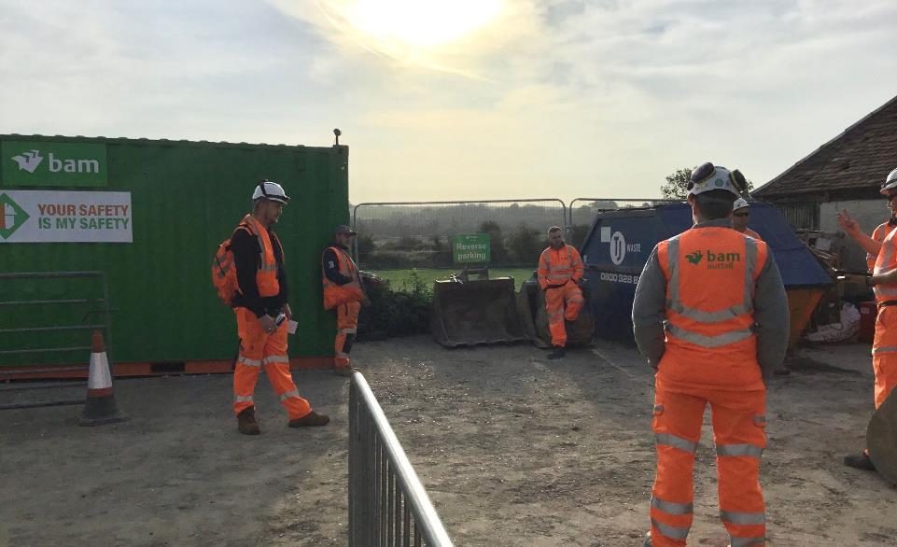

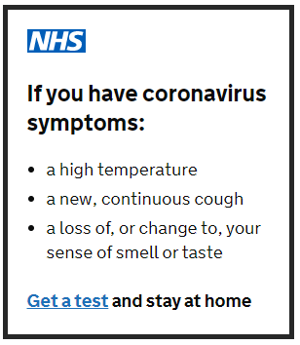

Finally...
Notes:
As a result of COVID19 many of us took less holidays in the Summer. So it’s possible that there may be lower numbers on site as we take our days off before the end of the year.
For those of us subsequently returning to work after a winter break it is important that we refresh our understanding of Safe Systems of Work and re-briefing on Risk Assessments / Method Statements and Work Package Plans is a vital component in ensuring we remain clear on the necessary controls to keep us healthy and safe in 2020.
COVID-19 has been with us for over six months now. It is important that we maintain our discipline when it comes to social distancing and hygiene requirements. Complacency cannot creep in. If you have Coronavirus symptoms – let us know, get a test and stay at home.
As always, Stop and think before starting any task.
Can I maintain social distancing?
Have I the right documentation for the job?
Have I the right PPE for the job?
Is there a safe access?
Is there sufficient lighting?
Have I the right plant and equipment?
Has the plant and equipment been maintained?
Have I been briefed?
Are all those around me safe?
If the answer is no to any of these, then take the required action or report to your supervisor before starting.
No job in this workplace is so important or so urgent that it can’t be done safely.
Let’s agree – no one is going to get harmed here.
Thank you

